Slide 1
Information System Security CMIS 422 Web programming security Module 5 Mona Taghavi

Slide 2
Session Overview
Attacks against browsers
Attacks targeting sensitive data
Injection attacks
Spam
Phishing attacks

Slide 3
Browser Attack Types
Man-in-the-browser
Trojan horse that intercepts data passing through the browser.
Keystroke logger
hardware or software that records all keystrokes entered.
not limited to browser interactions.
Page-in-the-middle
user is redirected to another page.
page attack might wait until a user has gone to a particular web site and present a fictitious page for the user.

Slide 4
Browser Attack Types
Program download substitution
the attacker presents a page with a desirable and seemingly innocuous program for the user to download
A user agreeing to install a program has no way to know what that program will actually do.
User-in-the-middle
A different form of attack puts a human between two automated processes so that the human unwittingly helps spammers register automatically for free email accounts.

Slide 5
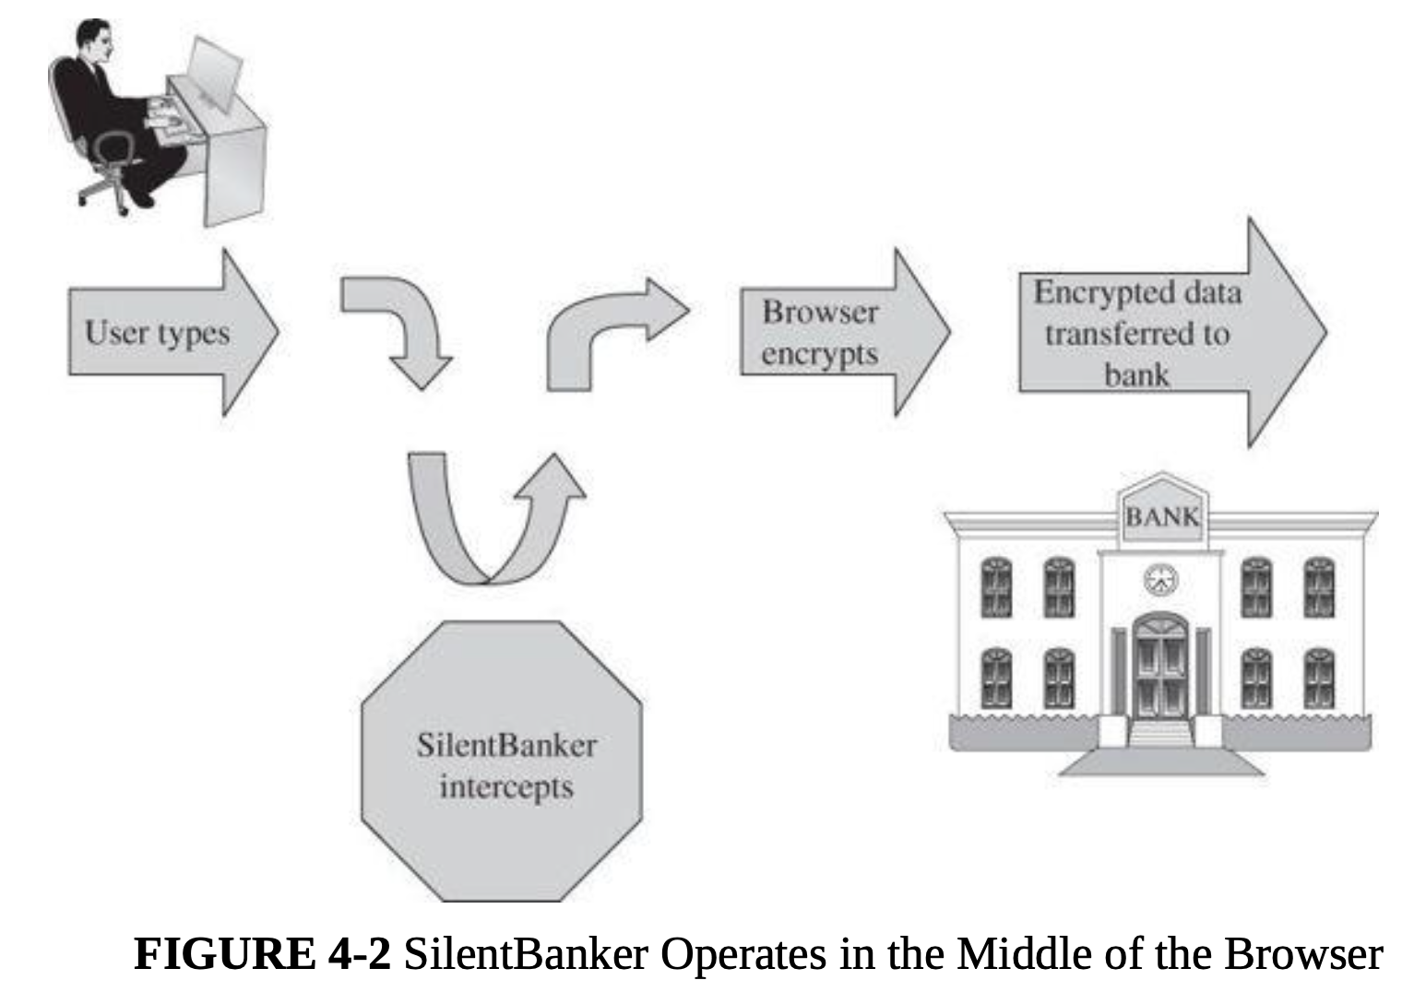
Man-in-the-browser

Slide 6
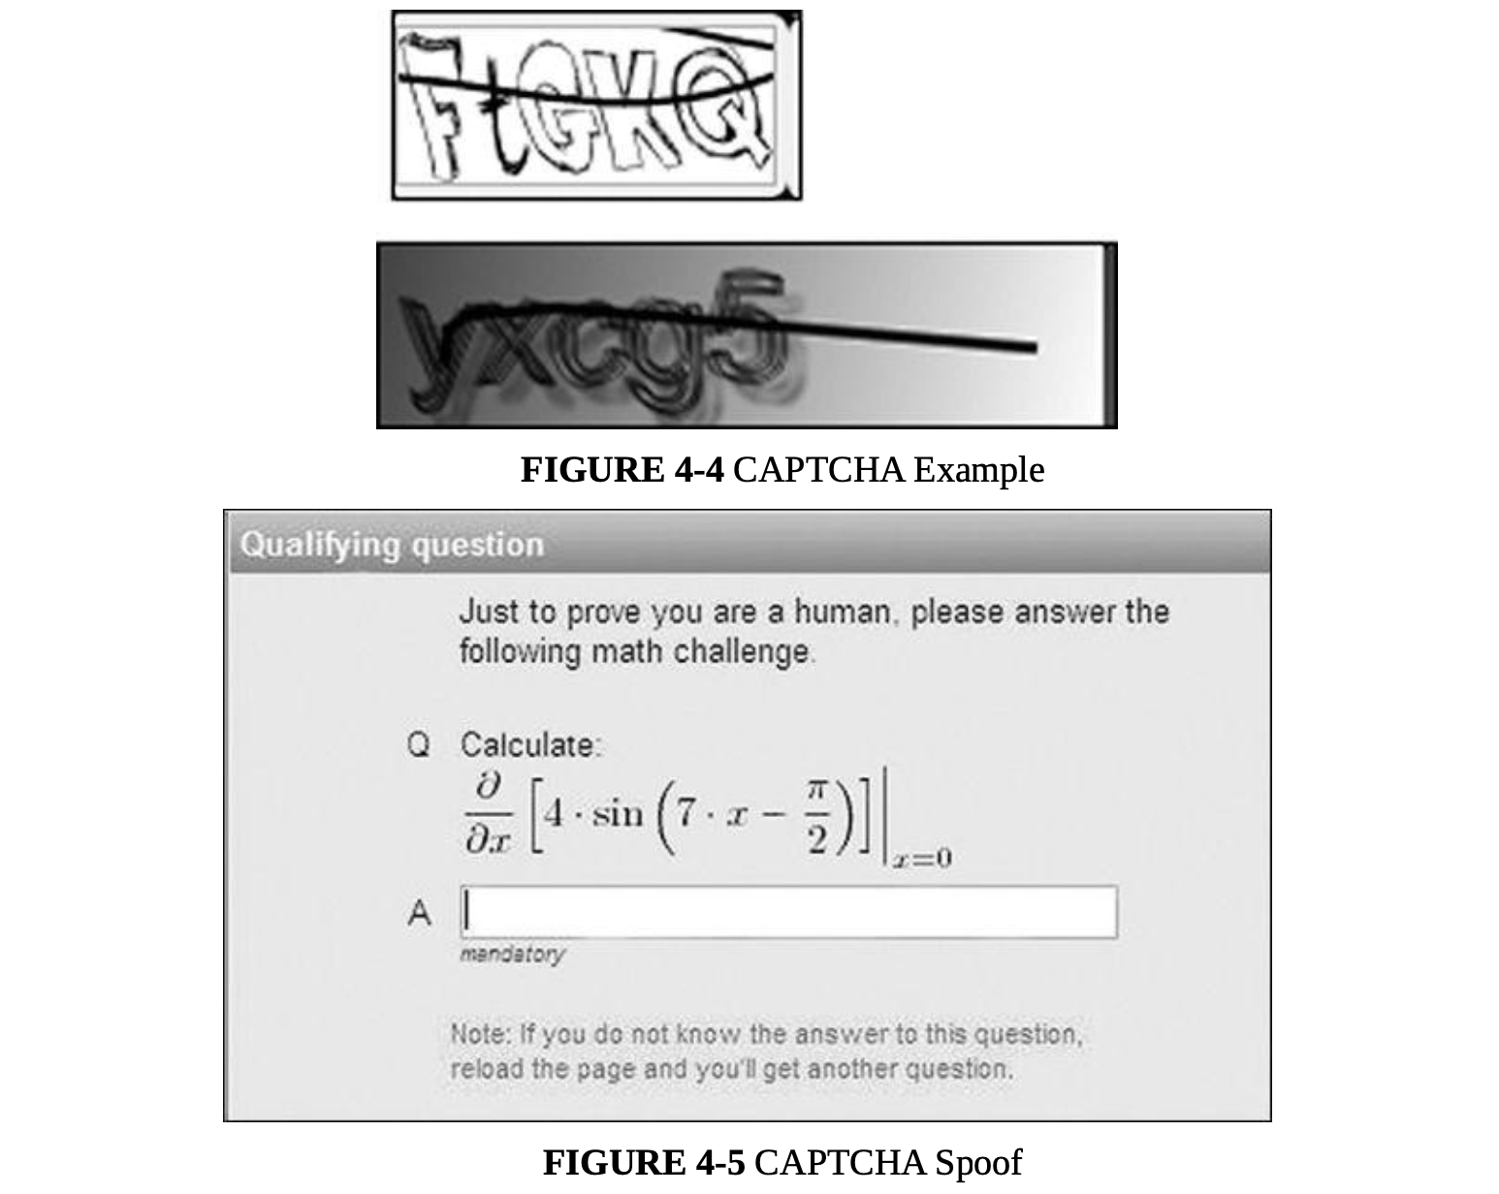
CAPTCHA
Notes:
First, the spam sender creates a site that will attract visitors; the author suggests a site with pornographic photos. Second, the spammer requires people to solve a CAPTCHA in order to enter the site and see the photos. At the moment a user requests access, the spam originator automatically generates a request to create a new email account (Hotmail, for example). Hotmail presents a CAPTCHA, which the spammer then presents to the pornography requester. When the requester enters the solution, the spammer forwards that solution back to Hotmail. If the solution succeeds, the spammer has a new account and allows the user to see the photos; if the solution fails, the spammer presents a new CAPTCHA challenge to the user. In this way, the attacker in the middle splices together two interactions by inserting a small amount of the account creation thread into the middle of the photo access thread. The user is unaware of the interaction in the middle.

Slide 7
How Browser attacks succeed
How the browsers attacks succeed?
The central failure of these in-the-middle attacks is faulty authentication.
authentication (human) is based on something you know, are, or possess.
When a user communicates online with a bank, the communication is really user-to-browser and computer-to-bank’s computer.

Slide 8
Successful Authentication
The attacks listed above are largely failures of authentication
Can be mitigated with
Shared secret
One-time password
Out-of-band communication

Slide 9
Web Attacks Targeting Users
Fake Website
Fake Code
Tracking Bug
Clickjacking
Drive-By Download
Cross-Site Scripting (XSS)
SQL Injection
Dot-Dot-Slash
Email Spam
Phishing

Slide 10
Fake Website

Slide 11
Fake Code

Slide 12
Tracking Bug

Slide 13
Clickjacking

Slide 14
Drive-By Download
Code is downloaded, installed, and executed on a computer without the user’s knowledge
May be the result of clickjacking, fake code, program download substitution, etc.

Slide 15
Cross-Site Scripting
Executable code is included in the interaction between client and server and executed by the client or server.

Slide 16
SQL Injection
Injecting SQL code into an exchange between an application and its database server
Example:
Loading an SQL query into a variable, taking the value of acctNum with malicious user input:
QUERY = "SELECT * FROM trans WHERE acct = '2468' OR '1'='1'; "

Slide 17
Dot-Dot-Slash
Also known as “directory traversal,” this is when attackers use the term “../” to access files that are on the target web server but not meant to be accessed from outside
Most commonly entered into the URL bar but may also be combined with other attacks, such as XSS

Slide 18

Dot-Dot-Slash
In both Unix and Windows, ‘..’ is the directory indicator for “predecessor.”
And ‘../..’ is the grandparent of the current location.
For example, passing the following URL causes the server to return the requested file, autoexec.nt, enabling an attacker to modify or delete it.

Slide 19
Email Spam
Experts estimate that 60% to 90% of all email is spam
Types of spam:
Advertising
Pharmaceuticals
Stocks
Malicious code
Links for malicious websites
Spam countermeasures
Laws against spam exist but are generally ineffective
Email filters have become very effective for most spam
Internet service providers use volume limitations to make spammers’ jobs more difficult

Slide 20
Phishing
A message that tries to trick a victim into providing private information or taking some other unsafe action
Spear phishing: A targeted attack that is personalized to a particular recipient or set of recipients

Slide 21
Countermeasures to Injections
Filter and sanitize all user input
Need to account for every potentially valid encoding
Make no assumptions about the range of possible user inputs—trust nothing, check everything
Use access control mechanisms on backend servers, such as “stored procedures”

Slide 22
Session Summary
As web browsers have become a primary focus of users and taken on greater functionality, they’ve become a focus of many types of attack
Browser and website weaknesses are often the result of some form of poor authentication
Many attackers focus on tricking users with fake websites, misleading applications, and phishing emails
On the server side, injection attacks are a key concern, and countermeasures to prevent them are critical

